Slide 1
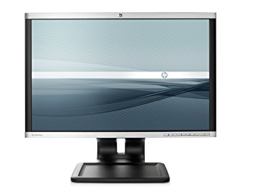
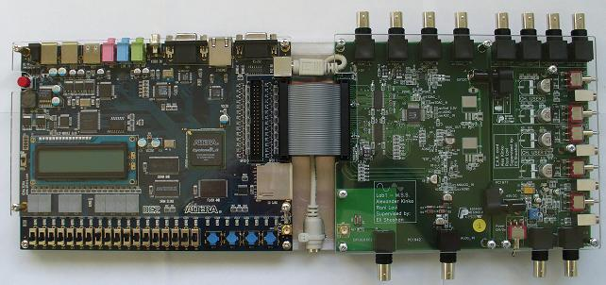
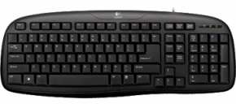

Background
Mario Move
Mario Draw
Object MUX
VGA Controller
KBD
Luigi Move
Luigi Draw
KBD
Bomb Gold Manager
Score
Obstacles
Manager
Sound Controller
Sound

